Slide 1


Waterfall Model: A Classic Approach to Software Development
The Waterfall Model, named for its sequential, cascading nature, is one of the oldest and most widely recognized approaches to software development. This method, often described as a linear and sequential process, divides the software development lifecycle (SDLC) into distinct phases, each building upon the previous one. The model's core principle is to ensure that each phase is completed before moving on to the next, minimizing overlaps and iterations. While the Waterfall Model might seem straightforward, it's important to understand its strengths, weaknesses, and the contexts in which it proves most effective. This presentation will explore the Waterfall Model's phases, its key characteristics, and its advantages and disadvantages in detail.
ra

Slide 2
Phases of the Waterfall Model
1
Requirements Gathering and Analysis
The initial phase involves meticulous gathering and documentation of all software requirements from the client or stakeholders. This process is crucial for defining the project's scope, functionality, and desired outcomes. Once the requirements are collected, they undergo rigorous analysis to ensure their feasibility, relevance, and clarity. This analysis helps to avoid potential conflicts, ambiguities, and unrealistic expectations.
2
System Design
Based on the finalized requirements, the system design phase takes shape, outlining the software's overall architecture and structure. This phase involves both high-level design (HLD), which focuses on the software's general structure, and detailed design (DD), which delves into the specifics of each component and module. System design acts as the blueprint for the subsequent implementation phase, ensuring a cohesive and well-organized software structure.
3
Implementation (or Coding)
In the implementation phase, the system design is translated into actual code. Developers diligently write code for the various components and modules, adhering to the established design specifications. This phase is the heart of software development, where the blueprint takes tangible form. The quality of implementation directly impacts the software's performance, reliability, and user experience.
4
Integration and Testing
Following the completion of the coding phase, the software components are brought together and integrated, followed by comprehensive testing to identify any potential bugs or defects. This critical phase ensures that the software functions as intended and meets the requirements outlined in the initial phases. Testing encompasses various methods, including unit testing, integration testing, system testing, and user acceptance testing, to cover all aspects of the software.
5
Deployment
Once the software successfully passes all testing phases, it is deployed to the production environment, making it accessible to users. This phase involves the installation and configuration of the software on the target systems, ensuring its smooth integration with existing infrastructure. The deployment process requires careful planning and execution to minimize downtime and ensure a seamless transition.
6
Maintenance
The software's life cycle continues with the maintenance phase, where any issues or bugs reported by users are addressed and resolved. Additionally, this phase includes regular updates with new features, enhancements, or bug fixes to ensure that the software remains relevant and meets evolving user needs. Effective maintenance is essential for the software's long-term stability, reliability, and usability.

Slide 3

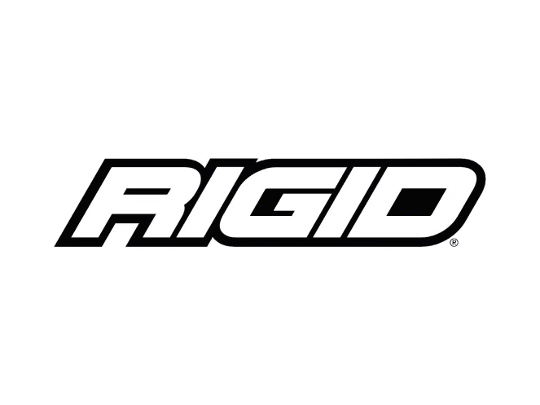
Key Characteristics of the Waterfall Model
1
Linear and Sequential
The Waterfall Model is characterized by its strict adherence to a linear progression through each phase. Each phase must be completed before moving on to the next, with no overlapping or iteration allowed. This approach emphasizes a structured and organized flow, ensuring that each phase is fully documented and finalized before proceeding to the next.
2
Documentation-Driven
Detailed documentation plays a central role in the Waterfall Model, serving as the foundation for each phase and facilitating communication and collaboration among team members. Detailed requirements documents, design specifications, test plans, and user manuals are created at each stage, ensuring a thorough record of the project's progress and decisions. This documentation ensures that everyone involved in the project has access to the same information and understands the project's trajectory.
3
Minimal Client Involvement After Initial Phases
Once the requirements are defined and the design is finalized, the client's involvement in the Waterfall Model typically diminishes until the testing and deployment phases. This approach assumes that the client's needs and requirements are well-understood and documented at the outset, minimizing the need for ongoing feedback and adjustments during development.
4
Rigid
The Waterfall Model is known for its rigidity, making it challenging to accommodate changes in requirements once the project has commenced. Any significant changes require a complete reevaluation and rework of the affected phases, potentially adding time and cost to the project. This rigidity can be a disadvantage in projects with evolving requirements or unpredictable circumstances.

Slide 4


Advantages of the Waterfall Model
Clear Structure
The Waterfall Model's structured and linear nature provides a clear and straightforward framework for project management. Each phase has a defined scope and deliverables, making it easy to understand the project's flow and track progress. This clarity simplifies task allocation, resource management, and communication within the development team, contributing to a more efficient and organized workflow.
Easy to Manage
The Waterfall Model's linear approach simplifies project management, enabling teams to easily manage schedules, deadlines, and milestones. Each phase has a predictable duration and deliverables, making it easier to create and adhere to project timelines. This predictability reduces uncertainty and helps to ensure that the project stays on track, minimizing delays and cost overruns.
Well-Suited for Smaller Projects
The Waterfall Model is well-suited for smaller projects with well-defined requirements and a low risk of significant changes. The model's focus on thorough planning and documentation, as well as its linear approach, proves efficient in these scenarios, minimizing the need for extensive iteration and flexibility. When requirements are stable and clearly defined, the Waterfall Model can streamline development and deliver a successful outcome.

Slide 5
Disadvantages of the Waterfall Model
Inflexible
Risky for Large Projects
Delayed Testing
One of the most significant drawbacks of the Waterfall Model is its inflexibility. Once a phase is completed, going back and making changes can be a complex and time-consuming process, often requiring substantial rework and revisions. This rigidity can be problematic when requirements evolve or unforeseen issues arise, potentially delaying the project and increasing costs.
For large and complex projects, the Waterfall Model can be risky due to its lack of flexibility and its reliance on upfront planning. Any errors or changes discovered late in the development cycle can be costly and time-consuming to address, potentially leading to project delays, budget overruns, and diminished quality. The model's inability to adapt to changing circumstances can be a significant challenge for large-scale projects.
In the Waterfall Model, testing is typically performed towards the end of the development cycle, after the implementation phase is complete. This approach can lead to the discovery of issues only after significant time and resources have been invested. Delayed testing can result in costly bug fixes, rework, and potentially delays in project delivery.

Slide 6



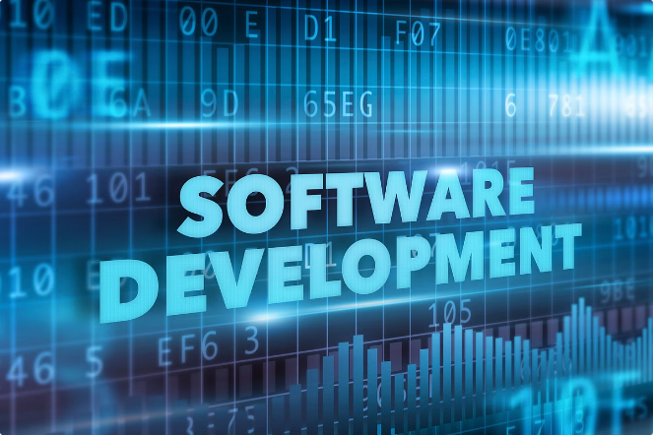


Alternatives to the Waterfall Model
Agile Methodology
The Agile methodology stands in contrast to the Waterfall Model by embracing iterative development and continuous feedback. Agile projects are divided into short cycles called sprints, with each sprint delivering a working increment of the software. This iterative approach allows for greater flexibility to adapt to changing requirements and deliver value to users more quickly. Agile methodologies prioritize collaboration, communication, and rapid iteration, making them well-suited for projects with uncertain requirements or evolving needs.
Spiral Model
The Spiral Model combines elements of the Waterfall Model with iterative development. It involves a series of cycles, each starting with planning and culminating in evaluation. This approach allows for risk assessment and mitigation at each cycle, making it suitable for complex and large projects. The Spiral Model emphasizes continuous refinement and adaptation, making it more flexible than the Waterfall Model.
Iterative Model
The Iterative Model, as its name suggests, involves developing the software in a series of iterations, with each iteration delivering a progressively more complete version of the software. This approach allows for early user feedback and continuous improvement, enabling the development team to adapt to changing requirements and deliver a more robust and user-centric product. The Iterative Model is particularly beneficial for projects with complex functionalities or evolving requirements.
Incremental Model
The Incremental Model builds upon the concept of iterations, but with a slightly different approach. Rather than delivering a complete version of the software in each iteration, the Incremental Model delivers functional increments of the software, gradually building upon the previous increment. This approach allows users to experience and provide feedback on functional parts of the software early on, enabling the development team to prioritize and refine features based on user needs. The Incremental Model is well-suited for projects with a large scope or complex functionalities.

Slide 7


When to Use the Waterfall Model
Small Projects
Well-Defined Requirements
Minimal Risk of Change
Stable Environment
Simple Applications
Clear Objectives
Limited User Involvement
Predictable Timeline

Slide 8


Conclusion
The Waterfall Model remains a valuable tool in the software development arsenal, particularly for smaller projects with well-defined requirements and a low risk of change. However, it's crucial to understand the model's limitations, especially its inflexibility and its potential for delayed testing. As software development projects become increasingly complex and dynamic, alternative methodologies like Agile and Iterative models have emerged as more adaptable and effective approaches. Choosing the right methodology for your project requires a careful assessment of its scope, requirements, and risks, ensuring that you select the approach that best aligns with your project's needs and objectives.

